Slide 1




Planning for the Impacts of Climate Change on North Carolina’s Agricultural Sector
WORKING DRAFT
2024 AI BOOTCAMP | PROJECT 3
CONTRIBUTORS: Mike Szumski and Jamie Bond

Slide 2
CONTENTS |  | PAGE
Executive Summary |  | 3
Background |  | 4
Approach |  | 5
Modeling and Analysis |  | 5
Findings and Conclusions |  | 13
Additional Questions |  | 14
Reference Content |  | 15
PROJECT OBJECTIVE
In this project, the University of North Carolina Charlotte / Chapel Hill AI Bootcamp project team examined the impacts of weather events, particularly flooding, on North Carolina agriculture and developed predictions about future impacts of climate change driven events on the state’s agricultural sector.

Slide 3
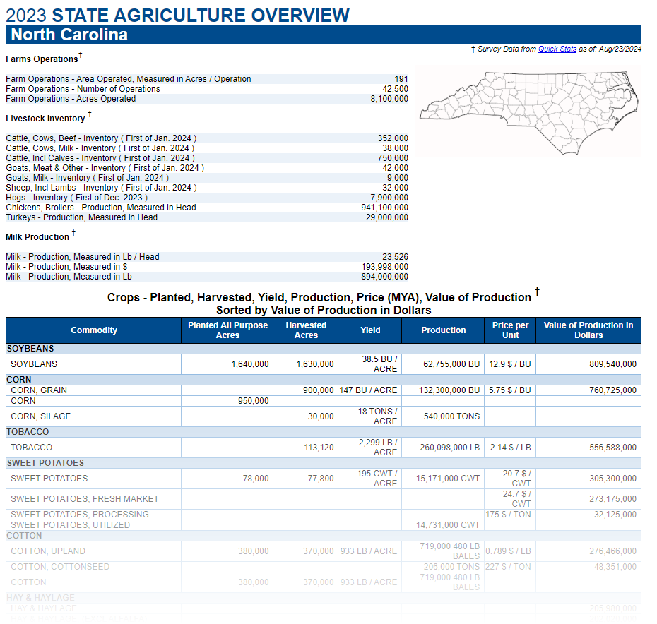


EXECUTIVE SUMMARY
PROJECT OBJECTIVE
To model the impacts of seasonal weather conditions on agricultural productivity and use the results to generate agricultural planning recommendations to local farmers.
Specifically, we aimed to develop a model for predicting yield and value of various North Carolina crops based seasonal weather forecasts which then feeds the results to a customized crop planning and protection recommendation engine for use by farmers.
PRIMARY DATA SOURCES
USDA National Agricultural Statistics Service (NASS)
National Integrated Drought Information System
NOAA Climate Perdition Center
APPROACH
Used historical weather and NC agricultural data train machine learning model to predict yields of various crops and respective market values.
Passed findings to decision model which levaged Ingested
KEY FINDINGS
Analyses revealed findings ….

Slide 4
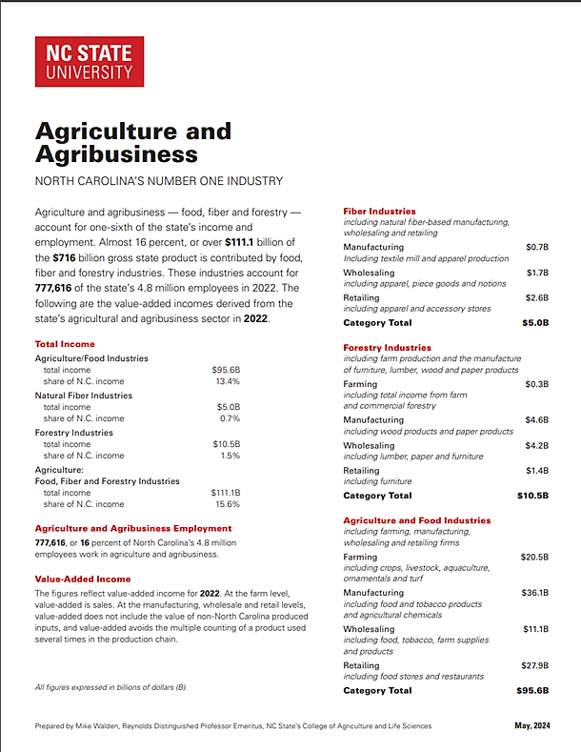
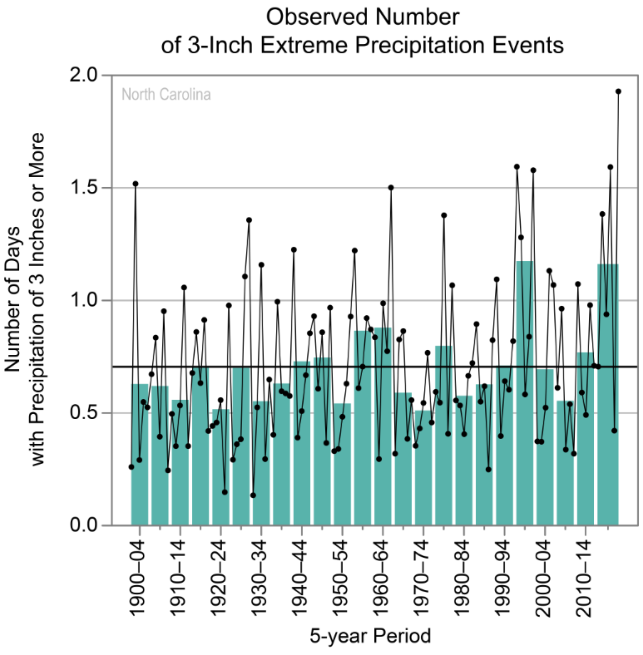
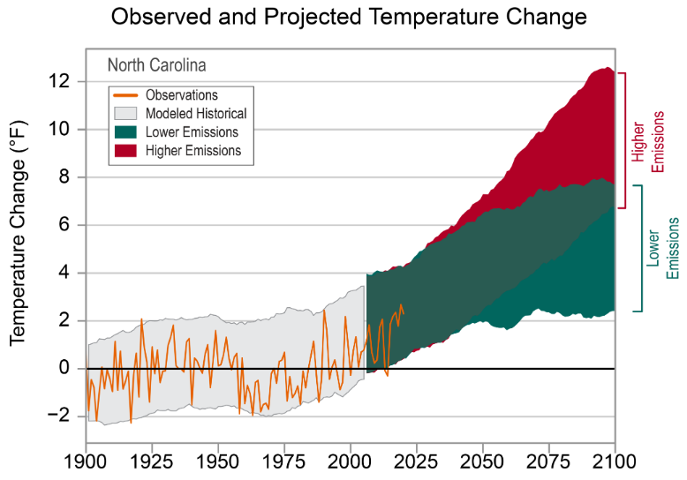
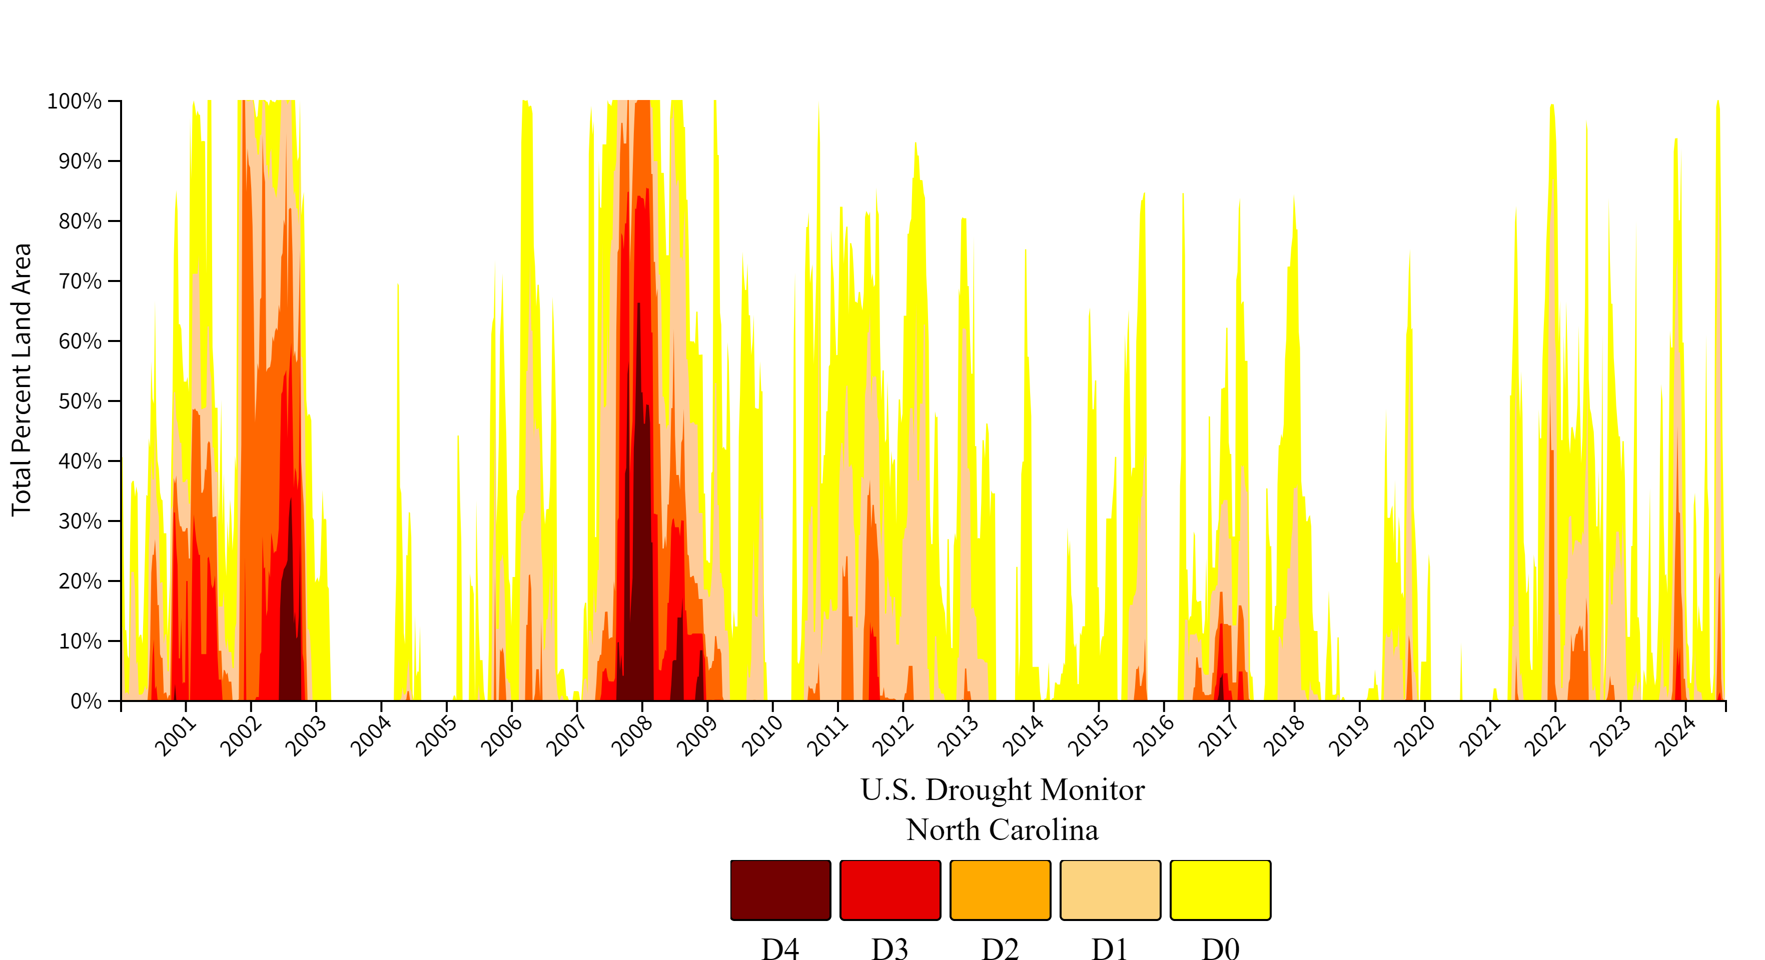
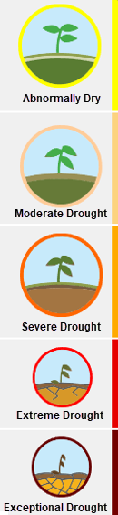
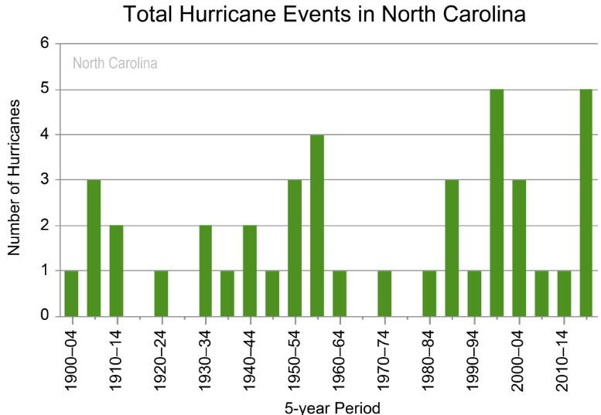
BACKGROUND
[ Warming trends and changes in precipitation patterns across the state …. Importance of agriculture to NC …]
Notes:
Precipitation - dots show annual values, bars show averages over 5-year periods (last bar is a 6-year average), and the horizontal black lines show the long-term (entire period) averages
Temerature - bserved and projected changes (compared to the 1901–1960 average)

Slide 5


APPROACH
Embedding
[ Warming trends and changes in precipitation patterns across the state …. Importance of agriculture to NC …]
Weather Data
(Wx)
VECTOR STORE
I/O HANDLING
Data By Season
Temperature
Precipitation
Disaster
Assistance
Program Info
Model
Insurance
Program Info
Prompts
Agricultural
Data (Ag)
Data By Crop Type
Acreage Planted
Production
Yield
Price per Unit
Production Value
Ag Best
Practice Info
Parsers
RAG
LLM
Inputs
ML
Performance
Prediction
Model
Decision
Support
Model
Regression Analysis
Retrieval & Synthesis
TRAINING DATA
CROP
YIELDS
Crop Type
Location
PRODUCTION VALUE / ACRE
Timeframe
Crop Types
Barley Blueberries*
Corn Cotton Hay Oats Peanuts
Bell Peppers Pumpkins Soybeans Squash Sweet Potatoes Tobacco Wheat
CONFIDENCE LEVELS
Gradio
Outputs
Agent
Recommendation
TEMPERATURE
PRECIPITATION
Wx
Forecast
Customized
Crop Planning & Protection Plan

Slide 6
MODELING AND ANALYSIS
Machine Learning Modeling
Several regression models trained on NC weather data and NC crop data from 2000 to 2020.
RAG Design
Message Handling Model (LLM)
Decision Model

Slide 7
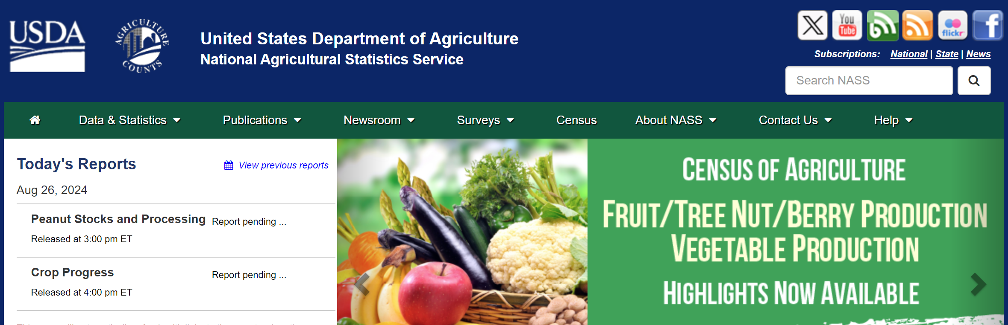
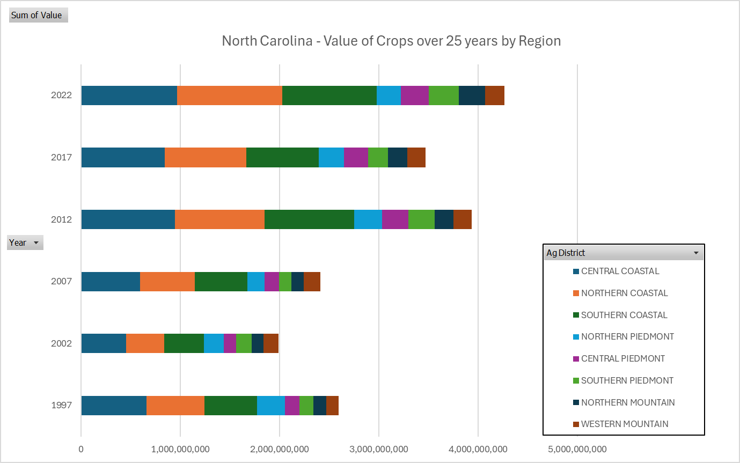
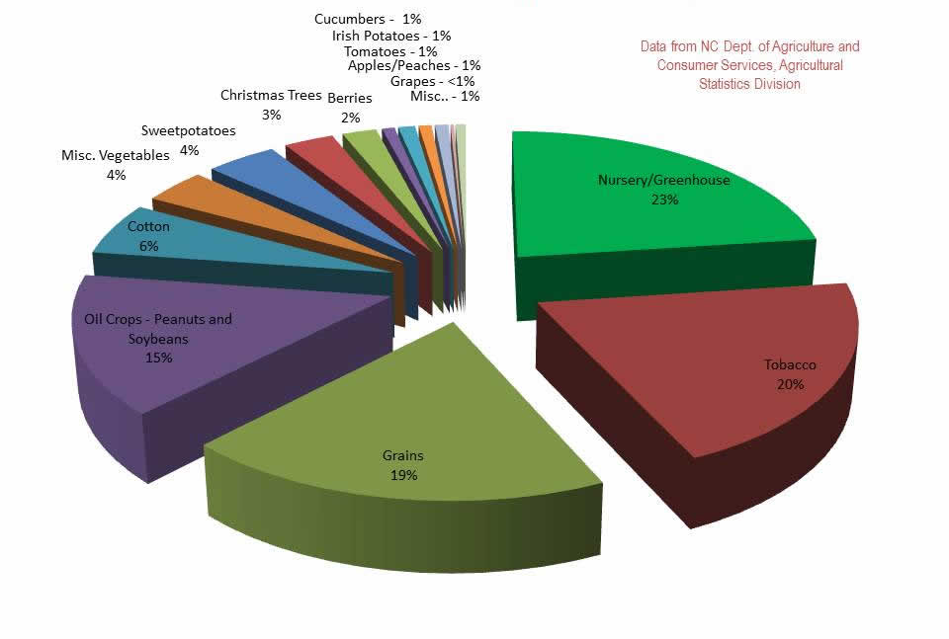
DATA SOURCES - CROPS
US Department of Agriculture National Agricultural Statistics Service
Census (5 yrs)
Surveys (ongoing)
Annual - weekly
National – states - counties
Notes:
Regarding the bar chart.
why did crop values decline in 2017?
The decline in crop value between 2012 and 2017 in North Carolina can be attributed to several factors:
Loss of farms: North Carolina lost approximately 4,000 farms (nearly 9% of total farms) between 2012 and 2017. This reduction in the number of farms likely contributed to a decrease in overall crop production and value.
Loss of mid-sized farms: There was a significant loss of farms sized between 50-500 acres (about 2,000 farms) and 10-50 acres (about 3,000 farms). These mid-sized farms are often crucial for local food production and sales to retail outlets.
Decrease in local food sales: North Carolina saw a 58% decrease in the number of farms selling local food to retail outlets. In 2012, North Carolina ranked 5th nationally with over 2,000 farms reporting wholesale sales. By 2017, this number dropped to 925 farms, ranking 10th nationally.
Shift in farm sizes: While losing mid-sized farms, North Carolina gained about 1,000 farms of fewer than 10 acres and 54 farms of more than 1,000 acres. This shift towards very small and very large farms may have impacted overall crop values.
Potential commodity price declines: Although not explicitly mentioned for North Carolina, the general trend of declining agricultural commodity prices between 2014 and 2019 likely affected North Carolina's crop values as well.
What caused the increase from 2017 to 2022?
Commodity price increases: After a period of low prices, many agricultural commodities saw significant price increases in 2021 and 2022. For example, the data shows that in North Carolina:
---Corn prices rose from $4.24 per bushel in 2017 to $5.95 in 2021
---Soybean prices increased from $9.50 per bushel in 2017 to $13.20 in 2021
---Cotton prices went up from $0.709 per pound in 2017 to $0.730 in 2021
2. Increased yields: Some crops saw yield improvements. For instance, the record high yield for corn in North Carolina was set in 2021 at 149.0 bushels per acre.
3. Shift in crop mix: There may have been changes in the types of crops grown, favoring higher-value crops. For example, sweet potato acreage reached a record high of 105,000 acres in 2021.
4. Recovery in local food sales: After the decline between 2012 and 2017, there may have been a rebound in farms selling to local and retail outlets, especially given increased interest in local food systems during the pandemic.
5. Growth in organic farming: The significant increase in organic farms and organic sales between 2012 and 2017 likely continued, contributing to higher overall crop values.

Slide 8
DATA SOURCES - Weather
US Department of Agriculture National Agricultural Statistics Service
Census (5 yrs)
Surveys (ongoing)
Annual - weekly
National – states - counties
Notes:
Regarding the bar chart.
why did crop values decline in 2017?
The decline in crop value between 2012 and 2017 in North Carolina can be attributed to several factors:
Loss of farms: North Carolina lost approximately 4,000 farms (nearly 9% of total farms) between 2012 and 2017. This reduction in the number of farms likely contributed to a decrease in overall crop production and value.
Loss of mid-sized farms: There was a significant loss of farms sized between 50-500 acres (about 2,000 farms) and 10-50 acres (about 3,000 farms). These mid-sized farms are often crucial for local food production and sales to retail outlets.
Decrease in local food sales: North Carolina saw a 58% decrease in the number of farms selling local food to retail outlets. In 2012, North Carolina ranked 5th nationally with over 2,000 farms reporting wholesale sales. By 2017, this number dropped to 925 farms, ranking 10th nationally.
Shift in farm sizes: While losing mid-sized farms, North Carolina gained about 1,000 farms of fewer than 10 acres and 54 farms of more than 1,000 acres. This shift towards very small and very large farms may have impacted overall crop values.
Potential commodity price declines: Although not explicitly mentioned for North Carolina, the general trend of declining agricultural commodity prices between 2014 and 2019 likely affected North Carolina's crop values as well.
What caused the increase from 2017 to 2022?
Commodity price increases: After a period of low prices, many agricultural commodities saw significant price increases in 2021 and 2022. For example, the data shows that in North Carolina:
---Corn prices rose from $4.24 per bushel in 2017 to $5.95 in 2021
---Soybean prices increased from $9.50 per bushel in 2017 to $13.20 in 2021
---Cotton prices went up from $0.709 per pound in 2017 to $0.730 in 2021
2. Increased yields: Some crops saw yield improvements. For instance, the record high yield for corn in North Carolina was set in 2021 at 149.0 bushels per acre.
3. Shift in crop mix: There may have been changes in the types of crops grown, favoring higher-value crops. For example, sweet potato acreage reached a record high of 105,000 acres in 2021.
4. Recovery in local food sales: After the decline between 2012 and 2017, there may have been a rebound in farms selling to local and retail outlets, especially given increased interest in local food systems during the pandemic.
5. Growth in organic farming: The significant increase in organic farms and organic sales between 2012 and 2017 likely continued, contributing to higher overall crop values.

Slide 9
RESULTS AND CONCLUSIONS
Impact of Weather to Crops
Perform of Models

Slide 10




















ADDITIONAL INVESTIGATION AREAS
MODEL LIMITATIONS
Geospatial Exploration
Location-specific weather and harvest data may reveal information about the impacts of topography (elevation and soil content) on crop yield
Enhanced Weather Data
Additional weather features such as humidity levels, atmospheric pressure and solar irradiance may reveal additional weather influences on yield
Infestations and Disease
Data related to crop-destroying insect populations and disease occurrences as well as pesticide use may reveal new insights on [WHAT?]
Influences of Farming Practices
Individual farming practices are likely to have a material influence on historic harvest data and are not accounted for in the model
Genetic Engineering Techniques
Model does not account for the use of seeds genetically modified for increased drought tolerance or pest resistance

Slide 11
REFERENCE CONTENT
GitHub
Project Repository: github.com/mikeszumski/AgProject3
Contributors
Michael Szumski | @mikeszumski (data wrangling, public health analysis)
Jamie Bond | @JBondAI (dataset identification, storytelling)
Data Providers

Slide 12
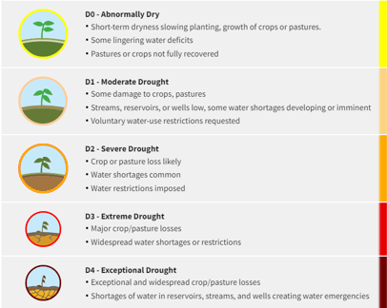
Place holder

Slide 13
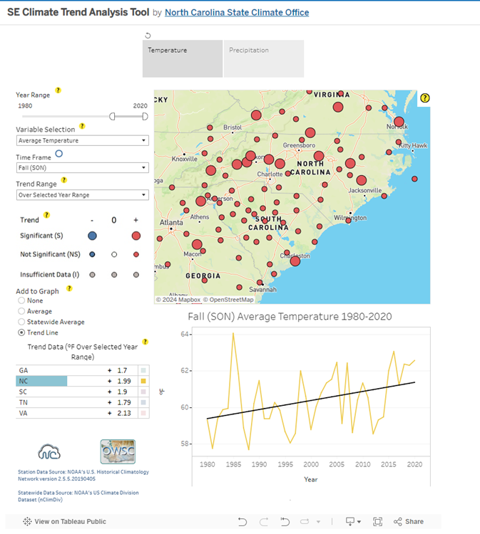
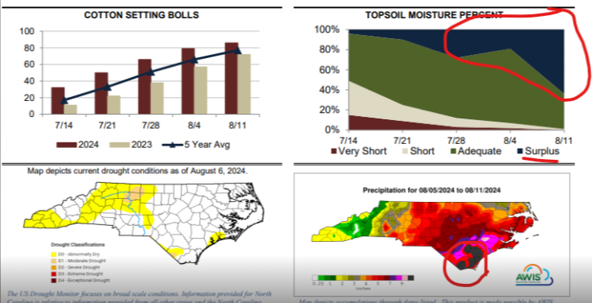
Precipitation and Temperature Data Source
https://public.tableau.com/app/profile/north.carolina.state.climate.office/viz/SEClimateTrendAnalysisTool/TrendAnalysisTool

Slide 14
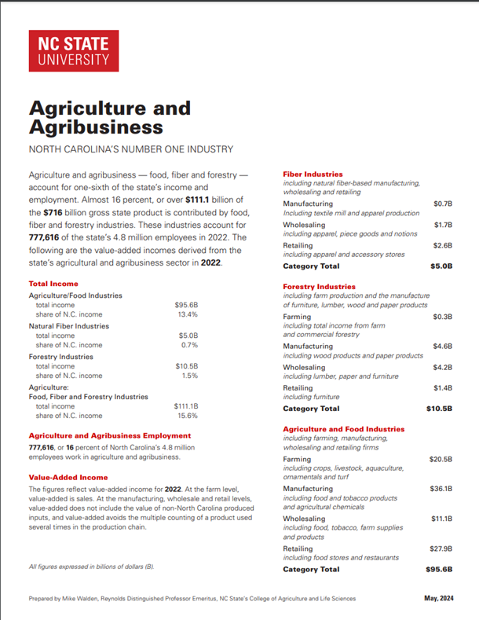
https://cals.ncsu.edu/agricultural-and-resource-economics/wp-content/uploads/sites/46/2017/07/AgricultureAgribusinessReport-2023-digital.pdf

Slide 15
APPROACH
Seasonal
Weather Data
(Wx)
FEATURES
Temperature
Precipitation
VECTORIZATION
CHAINING
Disaster
Assistance
Program Info
Prompts
Agricultural
Data (Ag)
TARGETS
Corn Yields
[Crop] Yields
[Crop] Yields
ML
Agriculture
Prediction
Model
Insurance
Program Info
Parsers
Harvest Prediction
Model
MODEL TRAINING
LLM
DA
Decisioning & Recommendation Model
Crop
Types
HARVEST
YIELDS
Net Benefit
PROFITABILITY
SEED COSTS
Wx
Forecast
CONFIDENCE LEVELS
COMMODITY PRICING
Financial Prediction
Model
TARGETS
Seed Costs
Commodity Pricing
Farm Protection Plan
Financial
Trends ($)
MODEL TRAINING
Notes:
Model takes precipitation and temperature
Find relationships plant advisor
Conditions

Slide 16
Planning and Protecting North Carolina Farmland against Climate Change
COURTESY OF:
Mike Szumski and Jamie Bond

